Slide 1
工作汇报
2018年10月17日

Slide 2
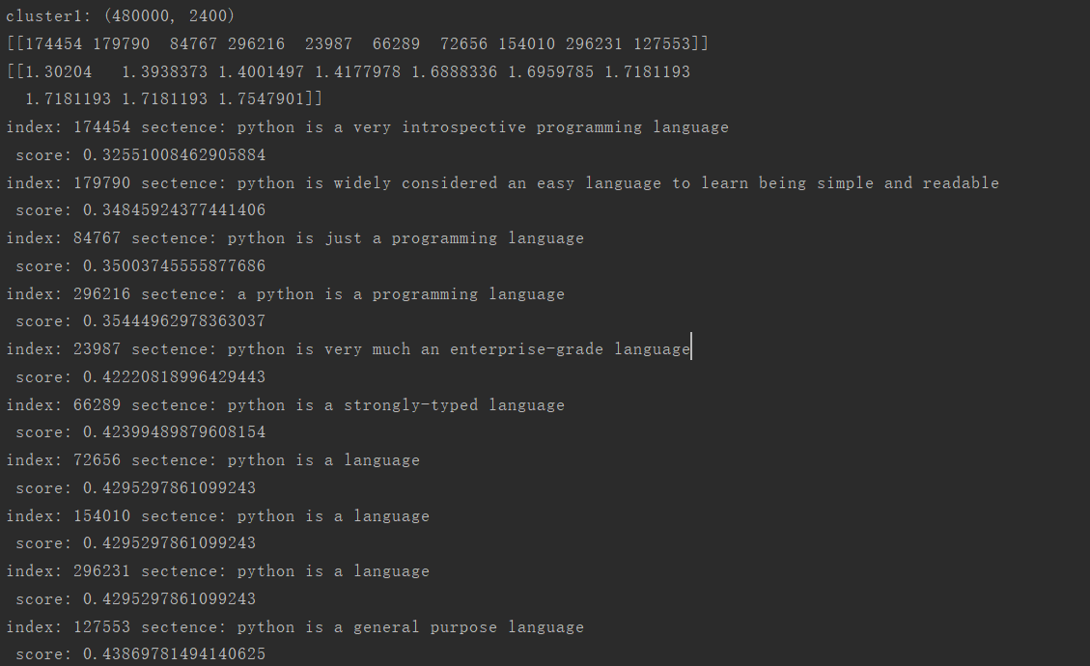
python is a widely used programming language
Notes:
采用不同的特征表达形式可以构造出不同的滤波组

Slide 3
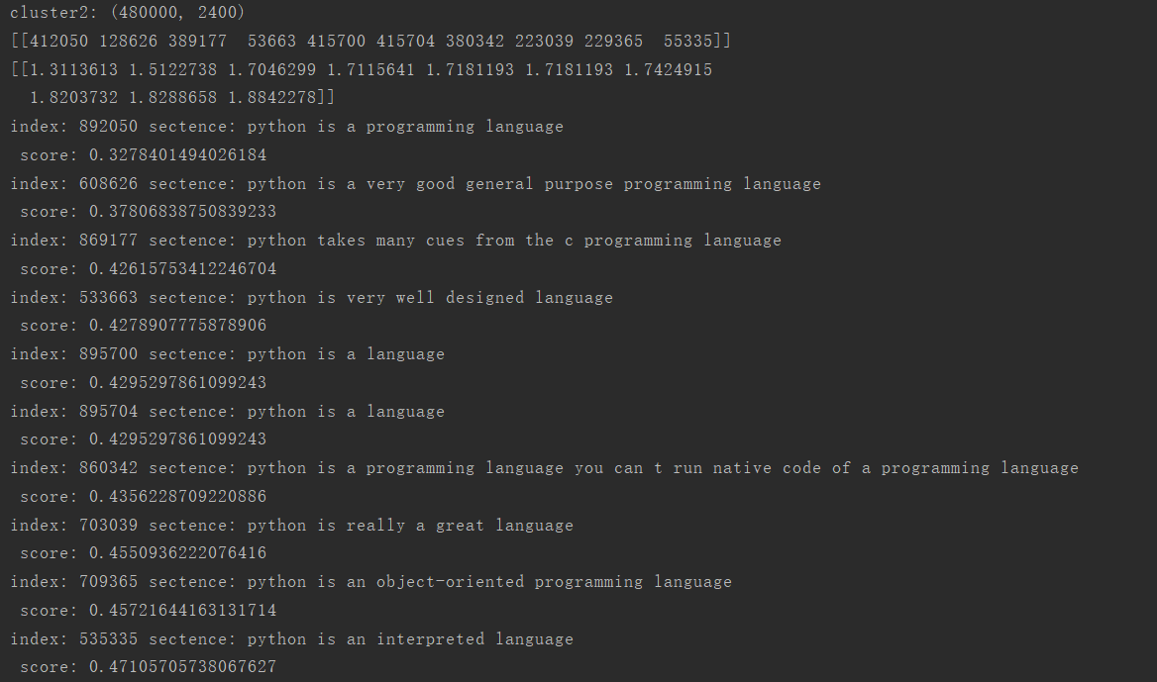
python is a widely used programming language
Notes:
采用不同的特征表达形式可以构造出不同的滤波组

Slide 4
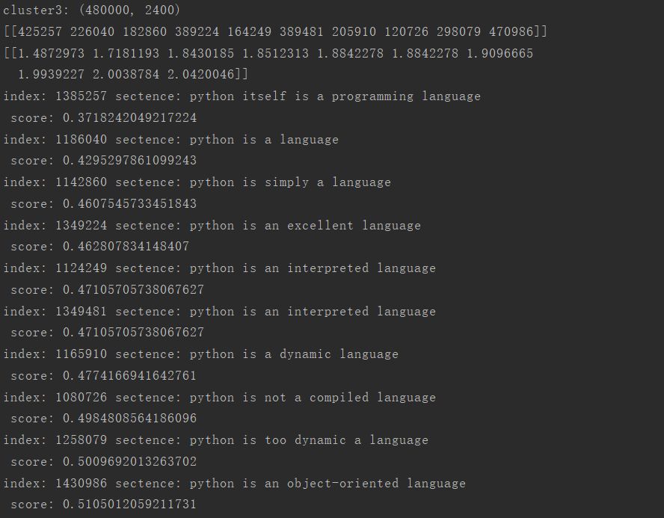
python is a widely used programming language
Notes:
采用不同的特征表达形式可以构造出不同的滤波组

Slide 5
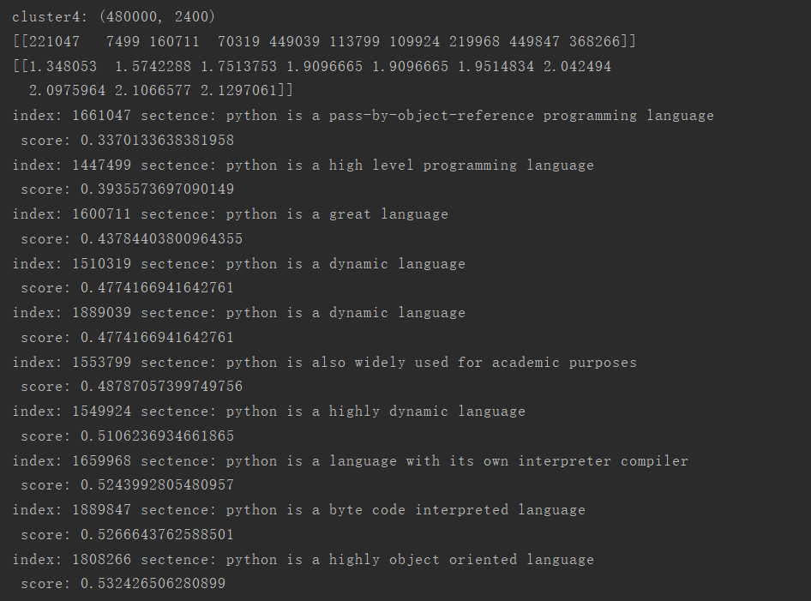
python is a widely used programming language
Notes:
采用不同的特征表达形式可以构造出不同的滤波组

Slide 6
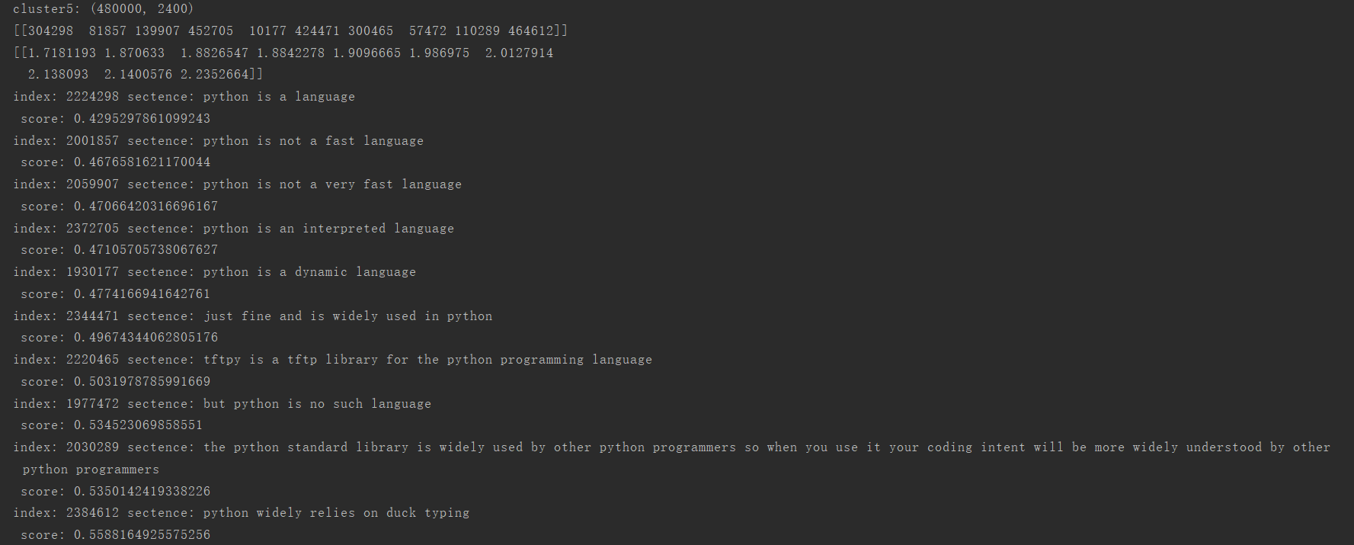
python is a widely used programming language
Notes:
采用不同的特征表达形式可以构造出不同的滤波组

Slide 7
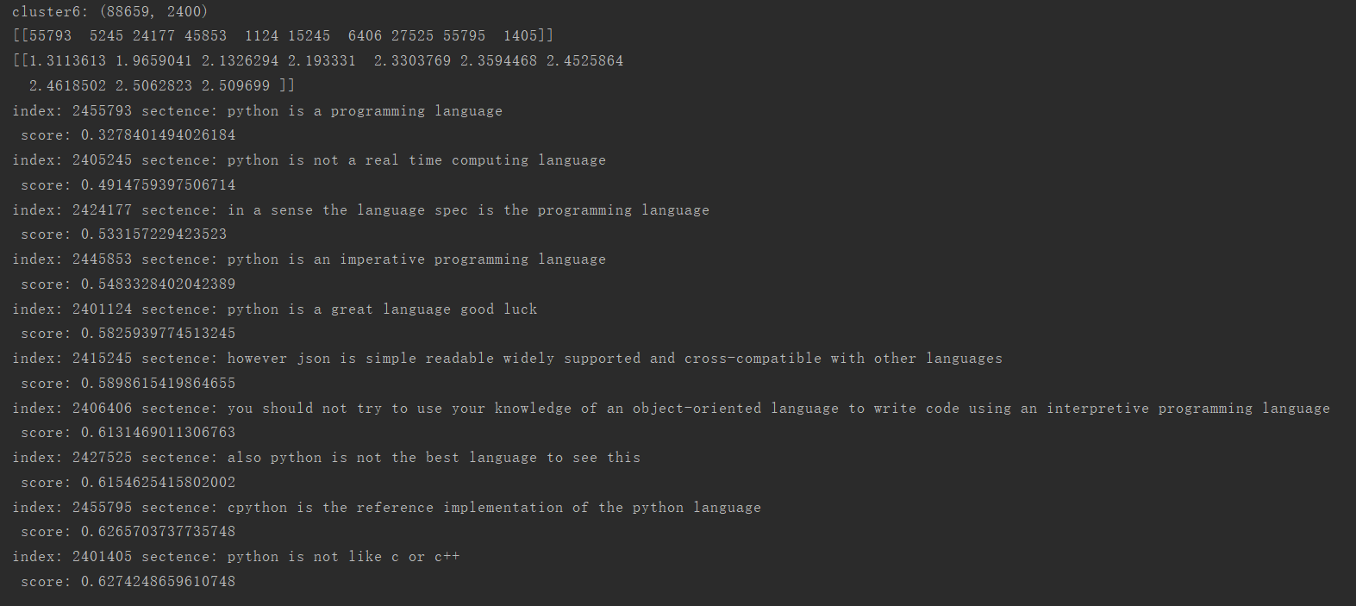
python is a widely used programming language
Notes:
采用不同的特征表达形式可以构造出不同的滤波组

Slide 8
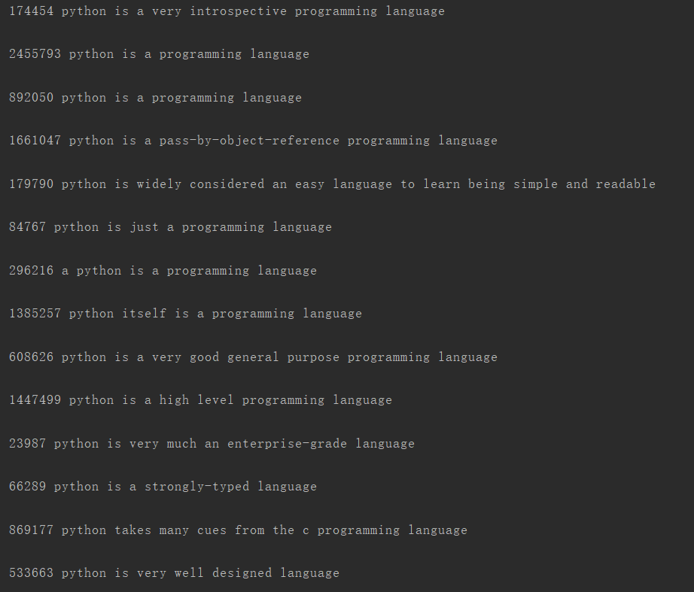
python is a widely used programming language
Sort：
Notes:
采用不同的特征表达形式可以构造出不同的滤波组

Slide 9
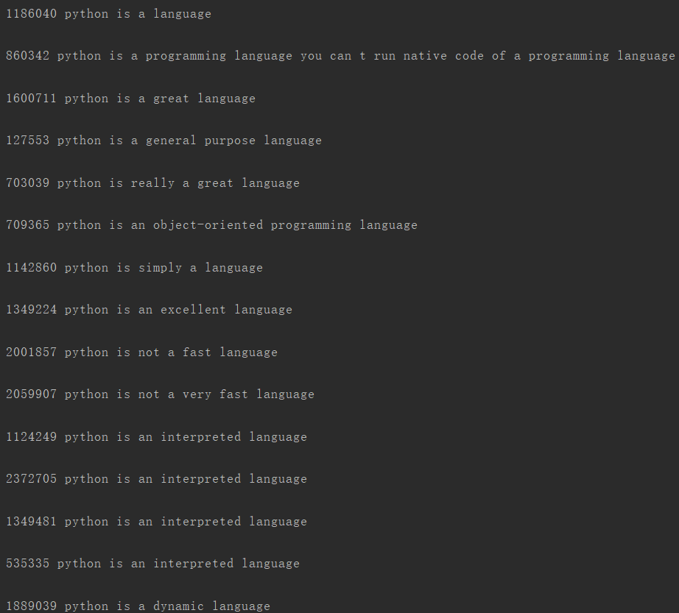
python is a widely used programming language
Notes:
采用不同的特征表达形式可以构造出不同的滤波组

Slide 10
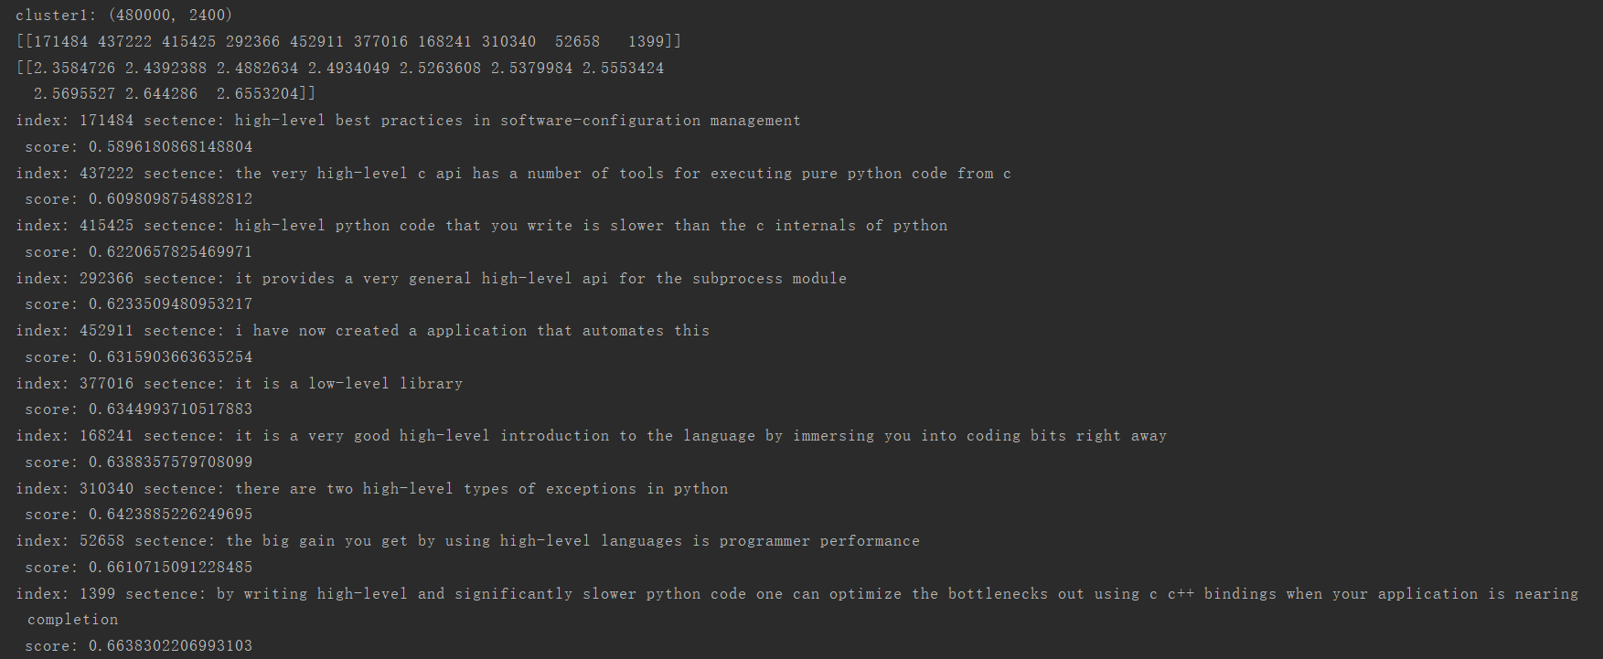
it is high-level python automates low-level operations such as memory management
Notes:
采用不同的特征表达形式可以构造出不同的滤波组

Slide 11
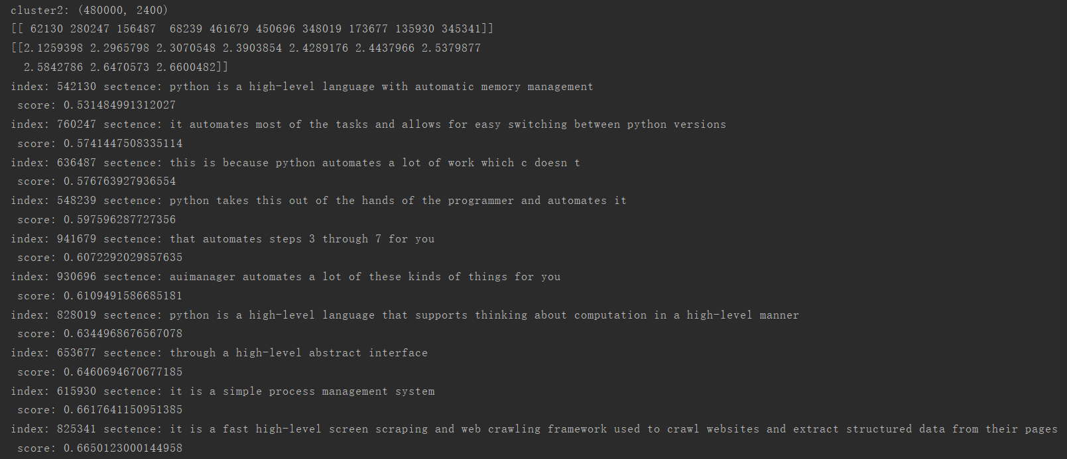
it is high-level python automates low-level operations such as memory management
Notes:
采用不同的特征表达形式可以构造出不同的滤波组

Slide 12
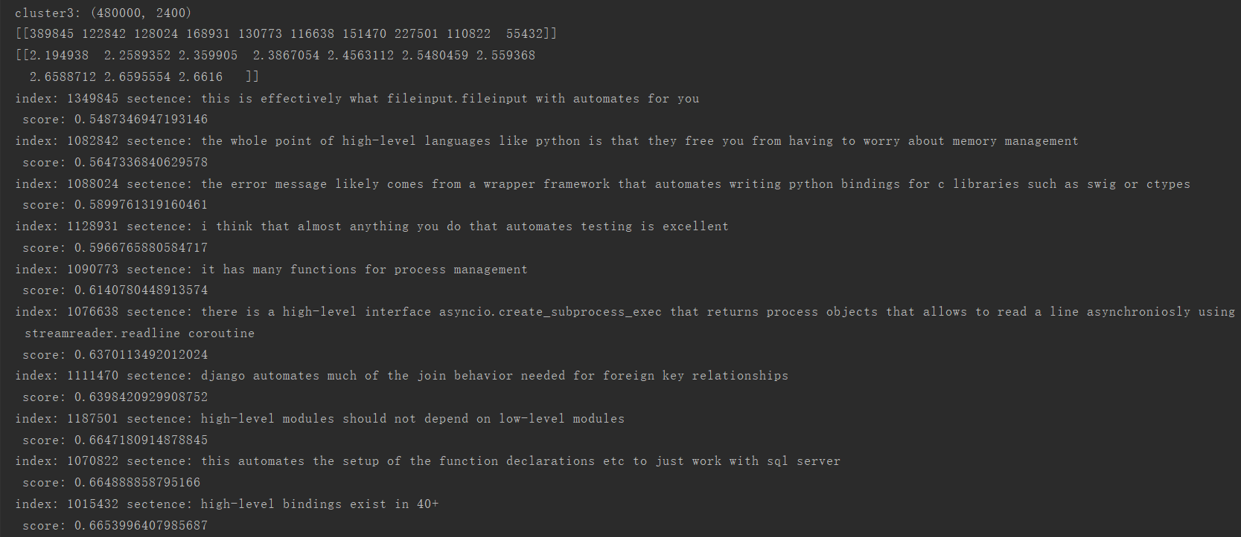
it is high-level python automates low-level operations such as memory management
Notes:
采用不同的特征表达形式可以构造出不同的滤波组

Slide 13
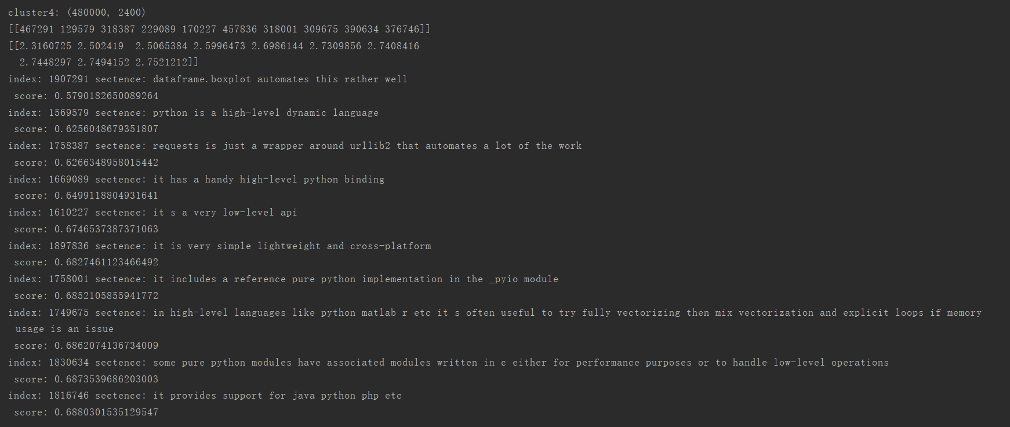
it is high-level python automates low-level operations such as memory management
Notes:
采用不同的特征表达形式可以构造出不同的滤波组

Slide 14
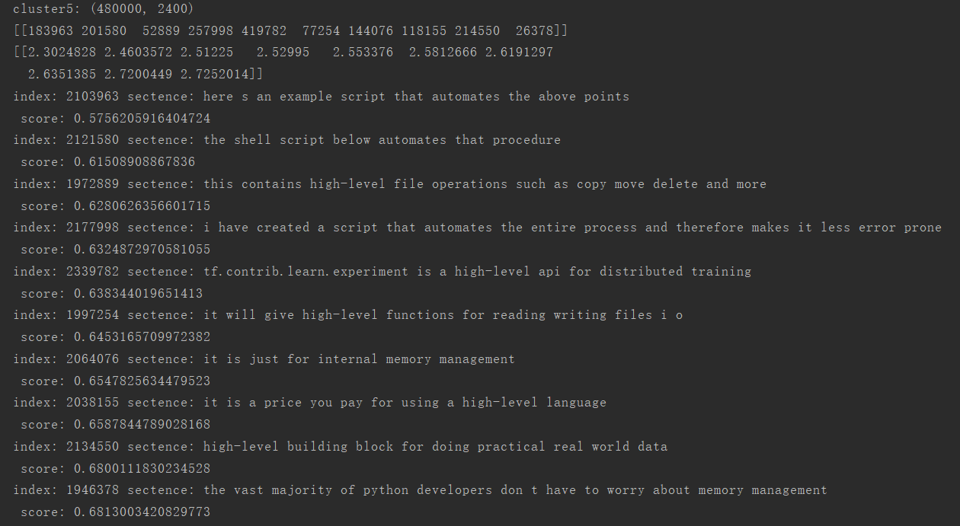
it is high-level python automates low-level operations such as memory management
Notes:
采用不同的特征表达形式可以构造出不同的滤波组

Slide 15
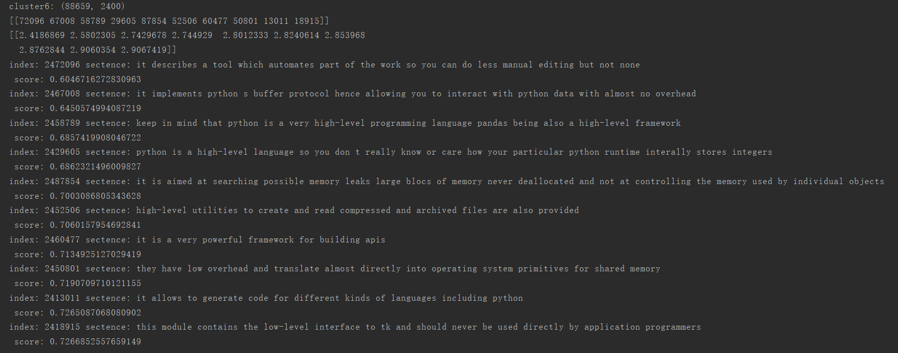
it is high-level python automates low-level operations such as memory management
Notes:
采用不同的特征表达形式可以构造出不同的滤波组

Slide 16
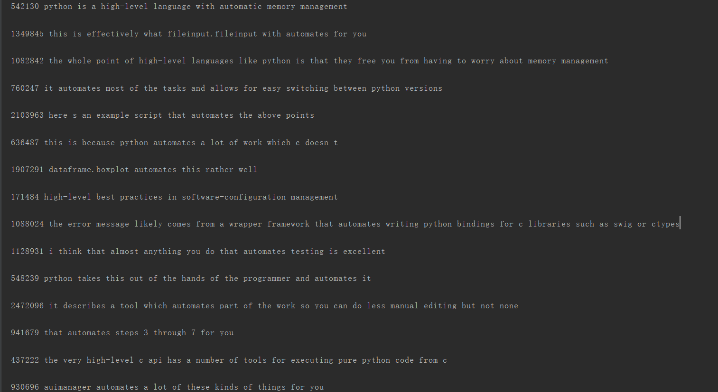
it is high-level python automates low-level operations such as memory management
Sort：
Notes:
采用不同的特征表达形式可以构造出不同的滤波组

Slide 17
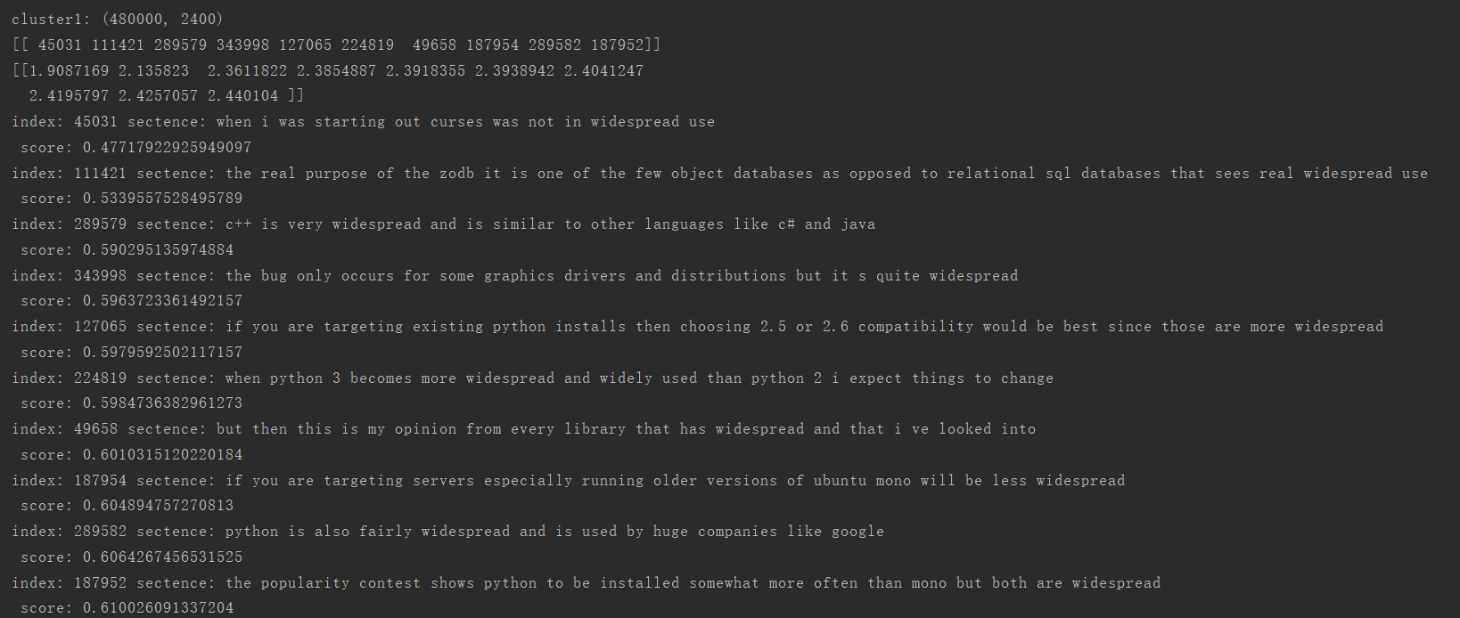
python 2.x is the legacy version although it still sees widespread use
Notes:
采用不同的特征表达形式可以构造出不同的滤波组

Slide 18
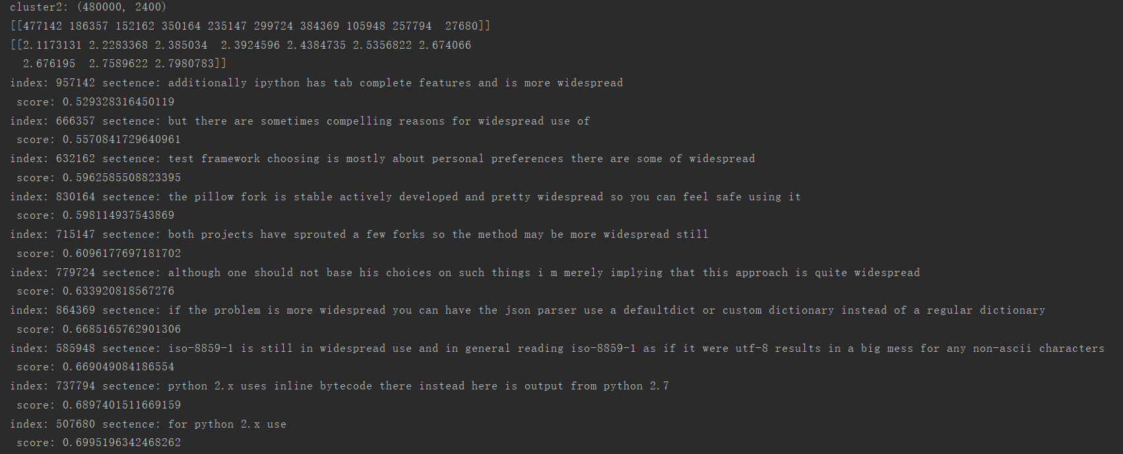
python 2.x is the legacy version although it still sees widespread use
Notes:
采用不同的特征表达形式可以构造出不同的滤波组

Slide 19
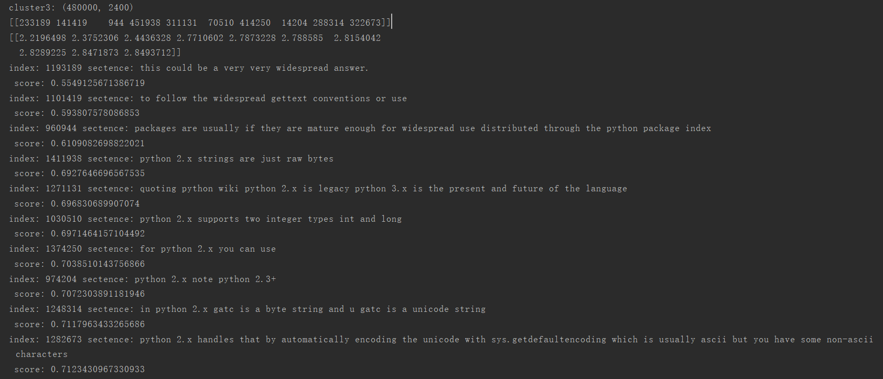
python 2.x is the legacy version although it still sees widespread use
Notes:
采用不同的特征表达形式可以构造出不同的滤波组

Slide 20
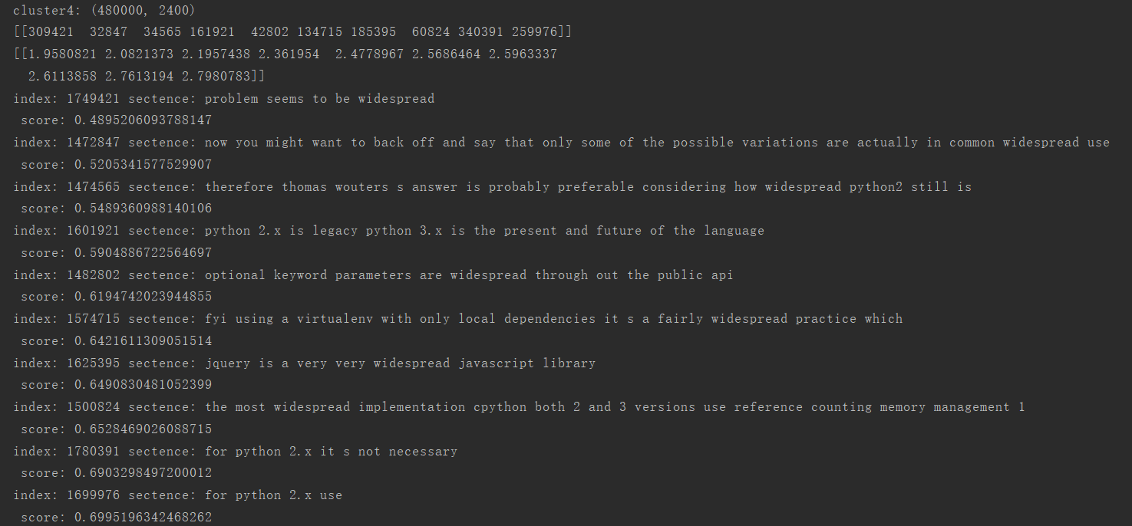
python 2.x is the legacy version although it still sees widespread use
Notes:
采用不同的特征表达形式可以构造出不同的滤波组

Slide 21
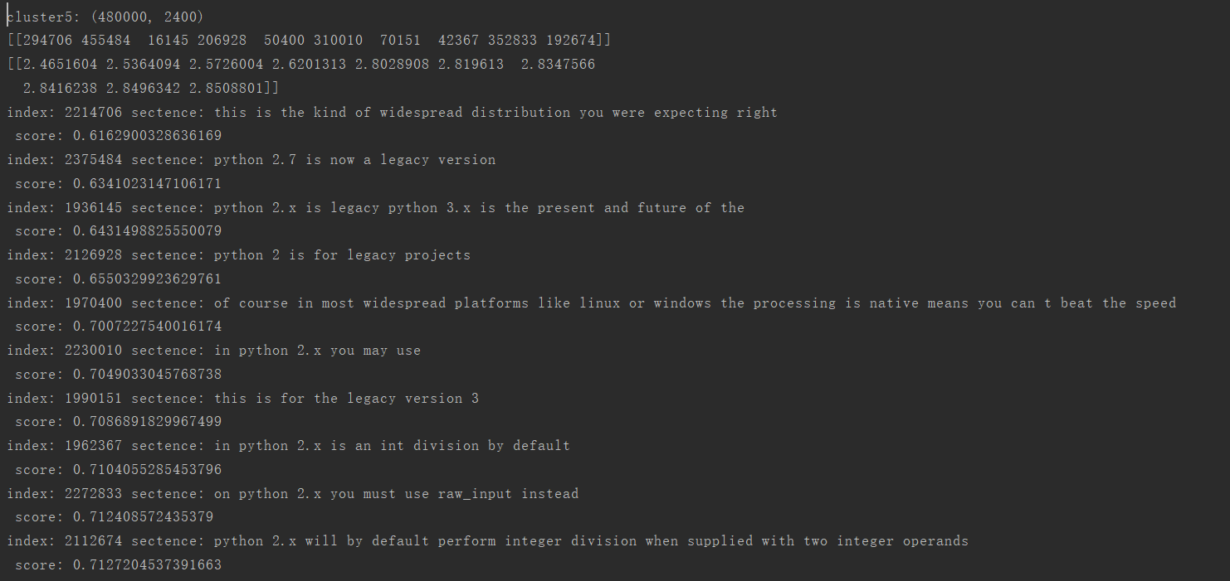
python 2.x is the legacy version although it still sees widespread use
Notes:
采用不同的特征表达形式可以构造出不同的滤波组

Slide 22
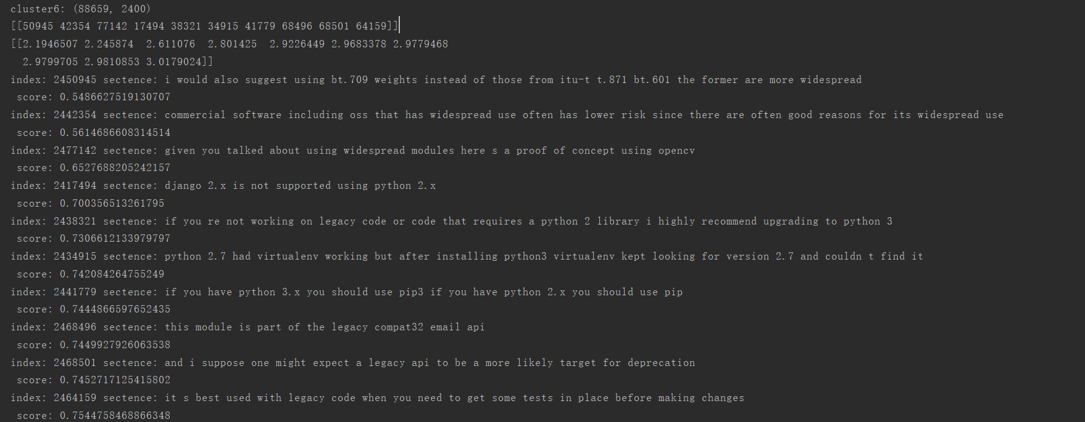
python 2.x is the legacy version although it still sees widespread use
Notes:
采用不同的特征表达形式可以构造出不同的滤波组

Slide 23
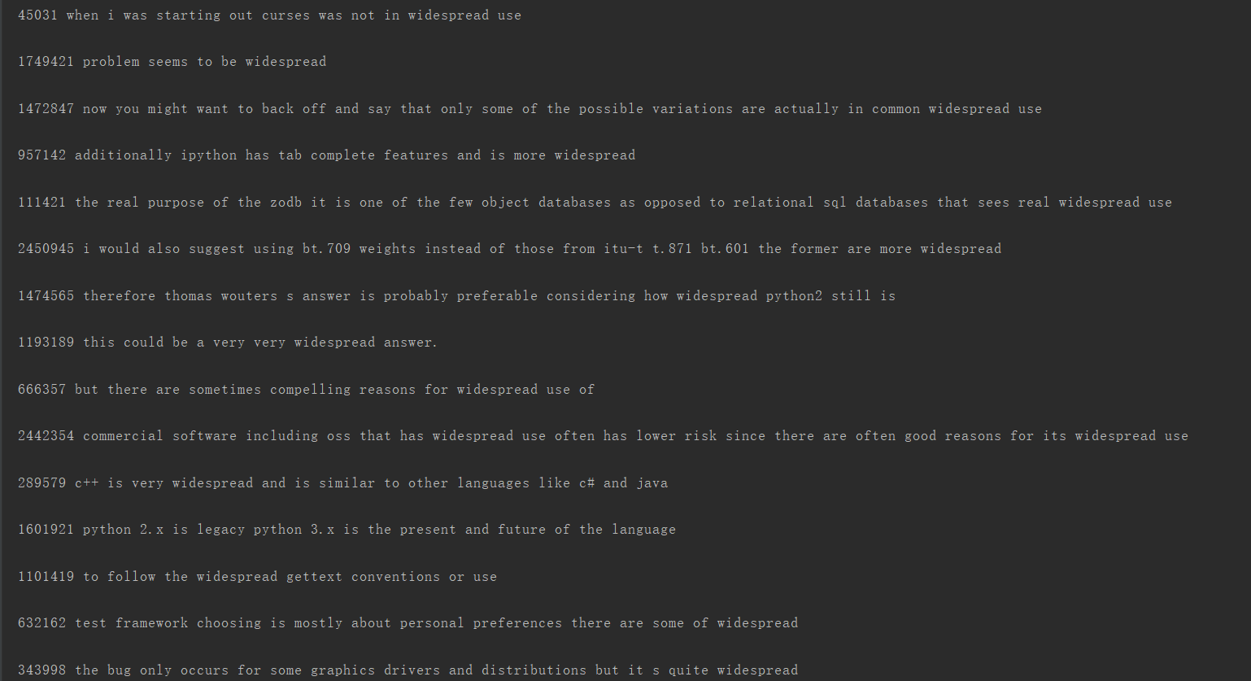
python 2.x is the legacy version although it still sees widespread use
Sort：
Notes:
采用不同的特征表达形式可以构造出不同的滤波组

Slide 24
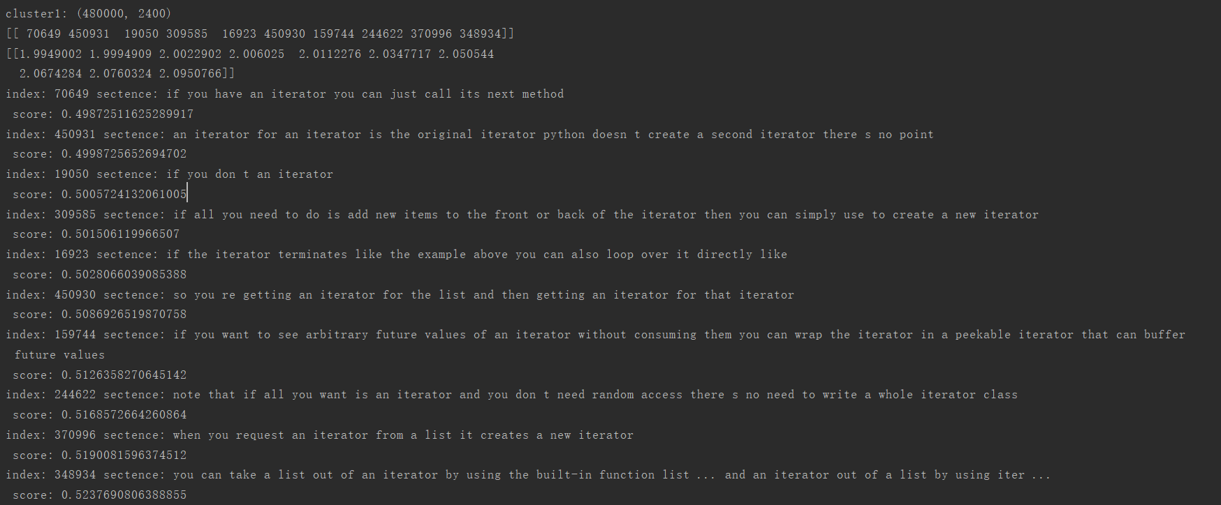
if an iterator does all the heavy lifting an empty for loop to just run the iterator can be useful
Notes:
采用不同的特征表达形式可以构造出不同的滤波组

Slide 25
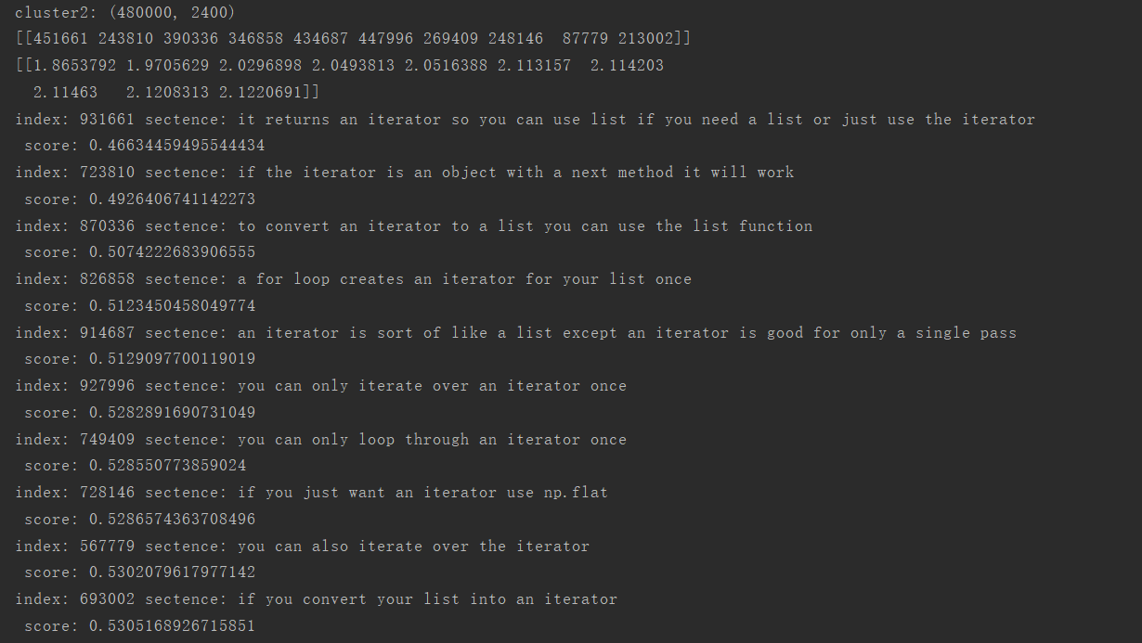
if an iterator does all the heavy lifting an empty for loop to just run the iterator can be useful
Notes:
采用不同的特征表达形式可以构造出不同的滤波组

Slide 26
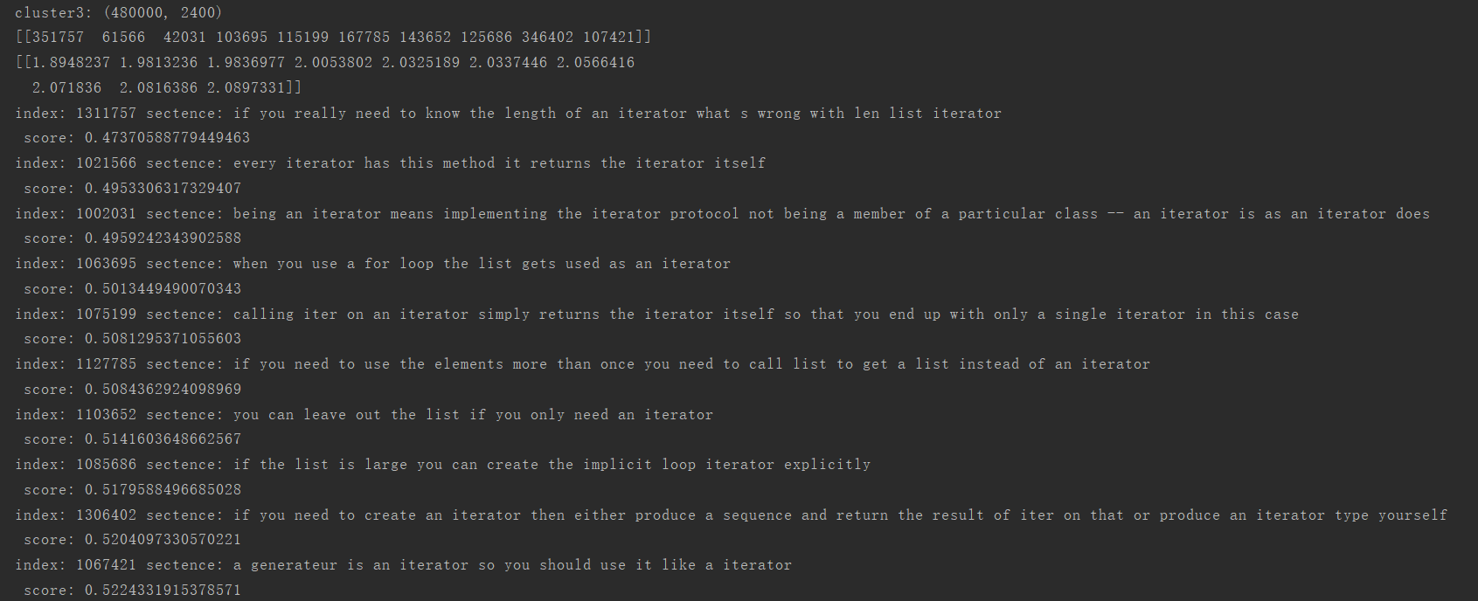
if an iterator does all the heavy lifting an empty for loop to just run the iterator can be useful
Notes:
采用不同的特征表达形式可以构造出不同的滤波组

Slide 27
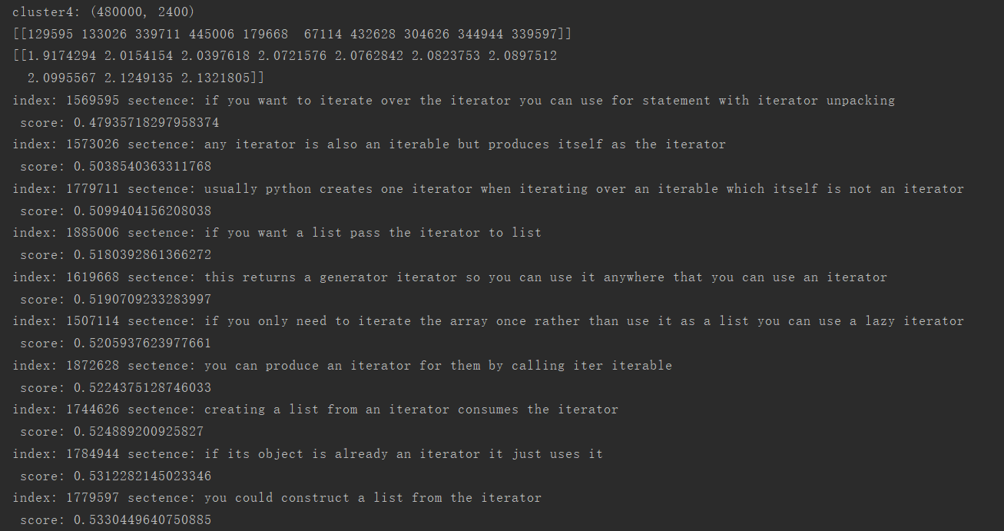
if an iterator does all the heavy lifting an empty for loop to just run the iterator can be useful
Notes:
采用不同的特征表达形式可以构造出不同的滤波组

Slide 28
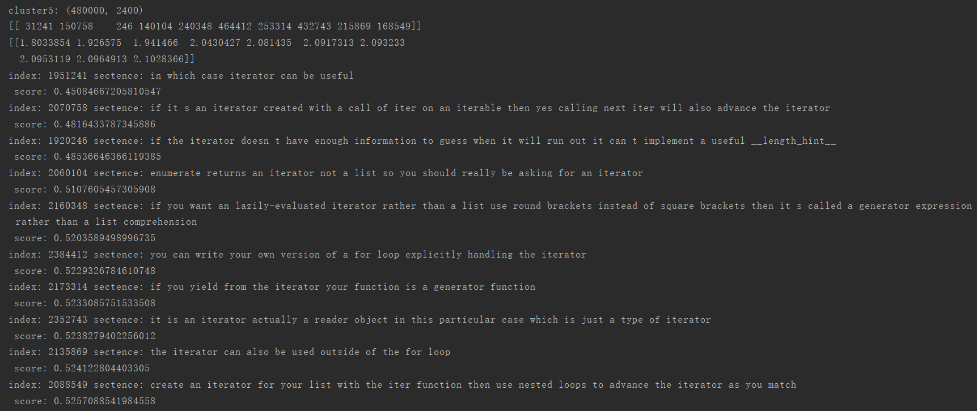
if an iterator does all the heavy lifting an empty for loop to just run the iterator can be useful
Notes:
采用不同的特征表达形式可以构造出不同的滤波组

Slide 29
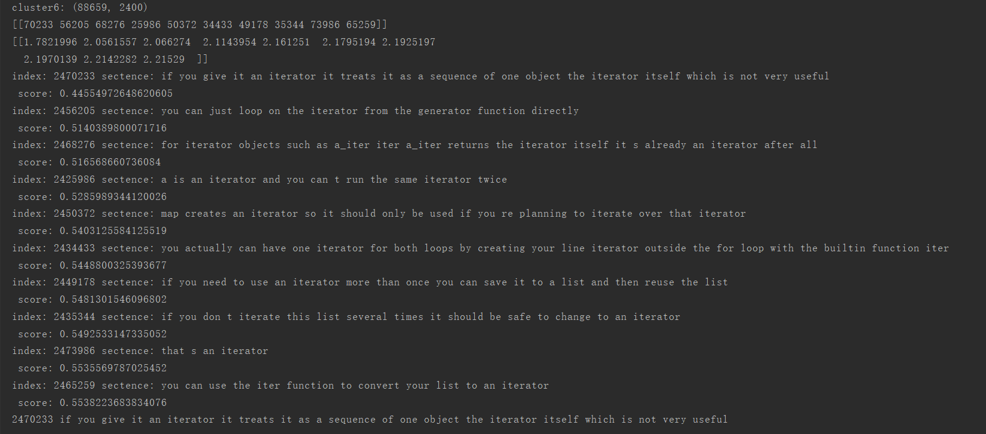
if an iterator does all the heavy lifting an empty for loop to just run the iterator can be useful
Notes:
采用不同的特征表达形式可以构造出不同的滤波组

Slide 30
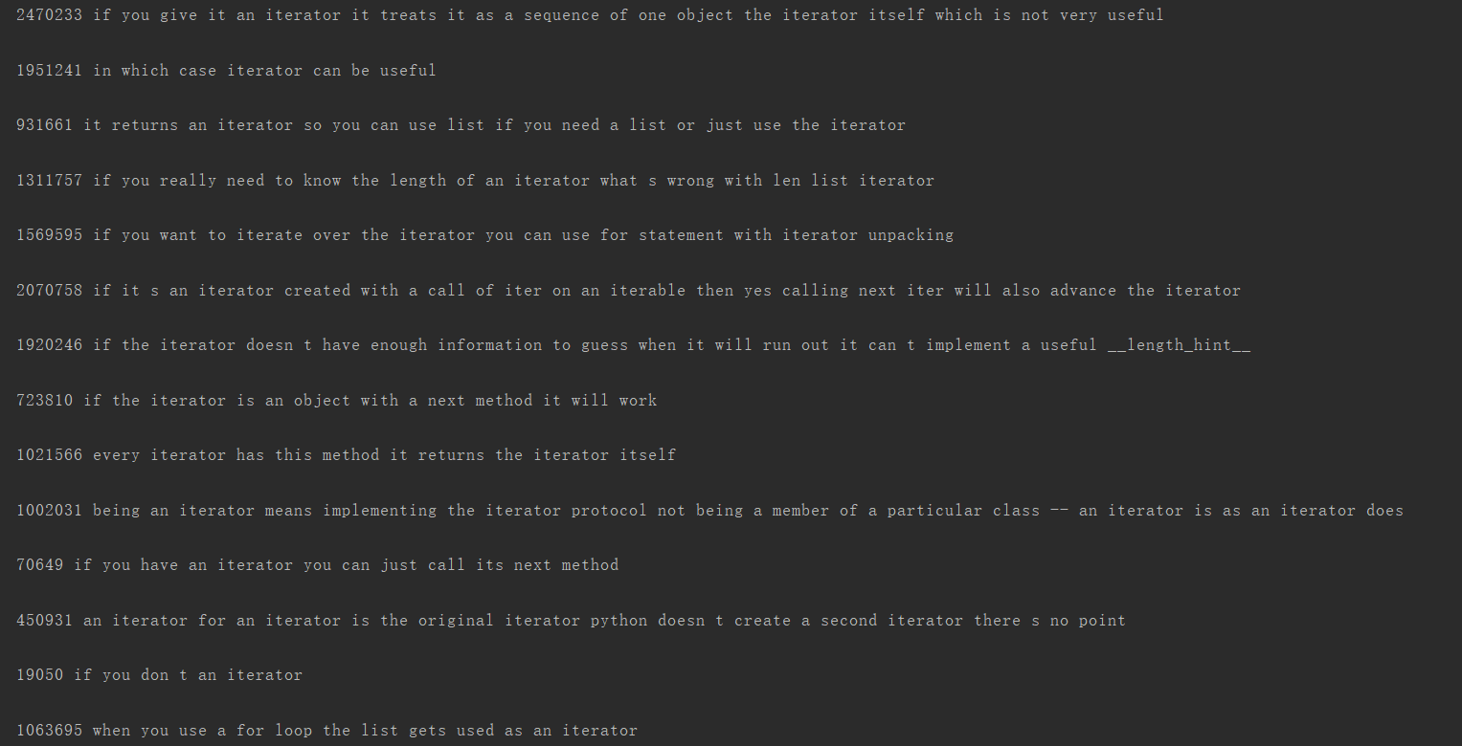
if an iterator does all the heavy lifting an empty for loop to just run the iterator can be useful
Sort：
Notes:
采用不同的特征表达形式可以构造出不同的滤波组

Slide 31
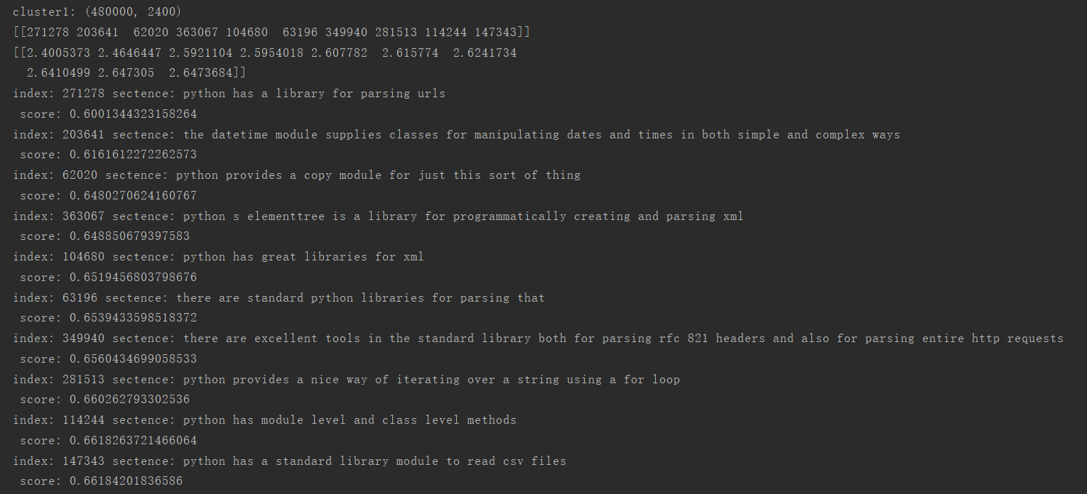
python provides both builtin methods and external libraries for creating modifying parsing and manipulating dates and times
Notes:
采用不同的特征表达形式可以构造出不同的滤波组

Slide 32
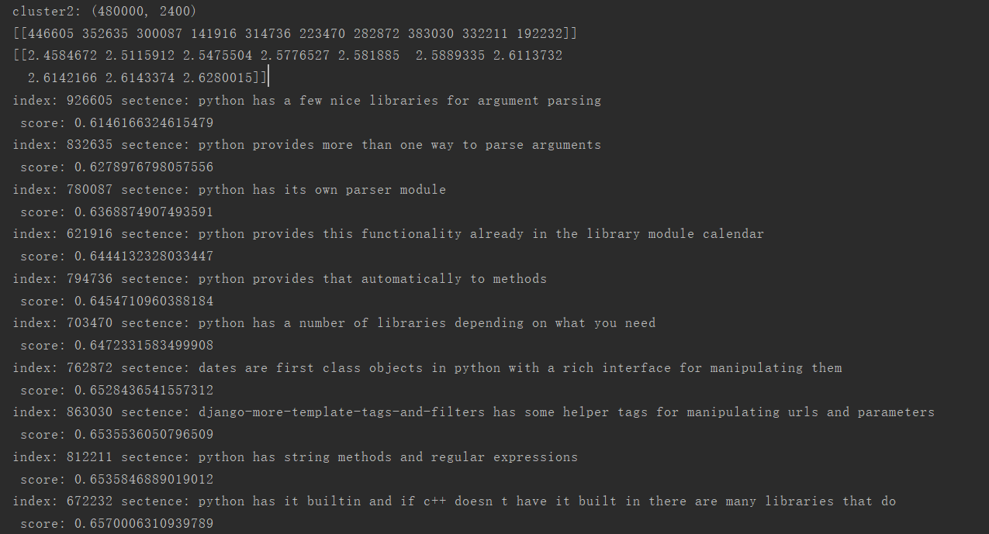
python provides both builtin methods and external libraries for creating modifying parsing and manipulating dates and times
Notes:
采用不同的特征表达形式可以构造出不同的滤波组

Slide 33
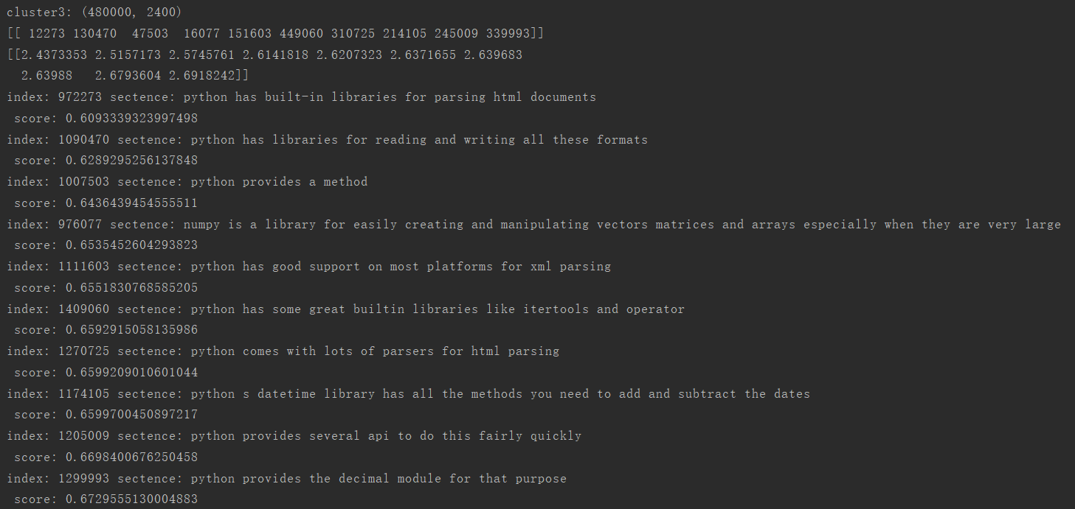
python provides both builtin methods and external libraries for creating modifying parsing and manipulating dates and times
Notes:
采用不同的特征表达形式可以构造出不同的滤波组

Slide 34
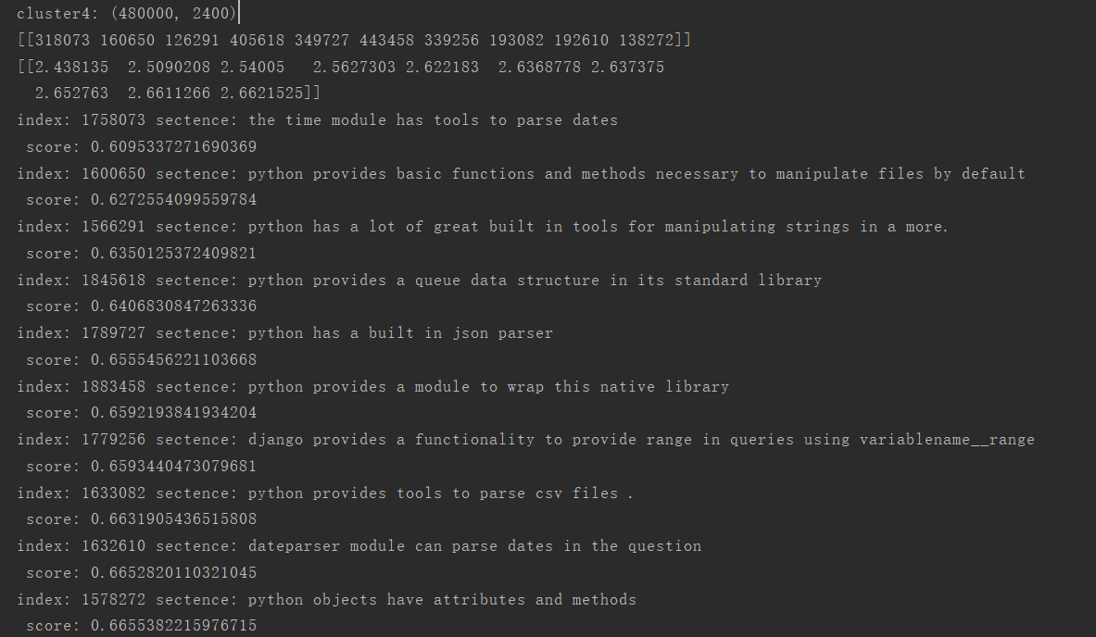
python provides both builtin methods and external libraries for creating modifying parsing and manipulating dates and times
Notes:
采用不同的特征表达形式可以构造出不同的滤波组

Slide 35
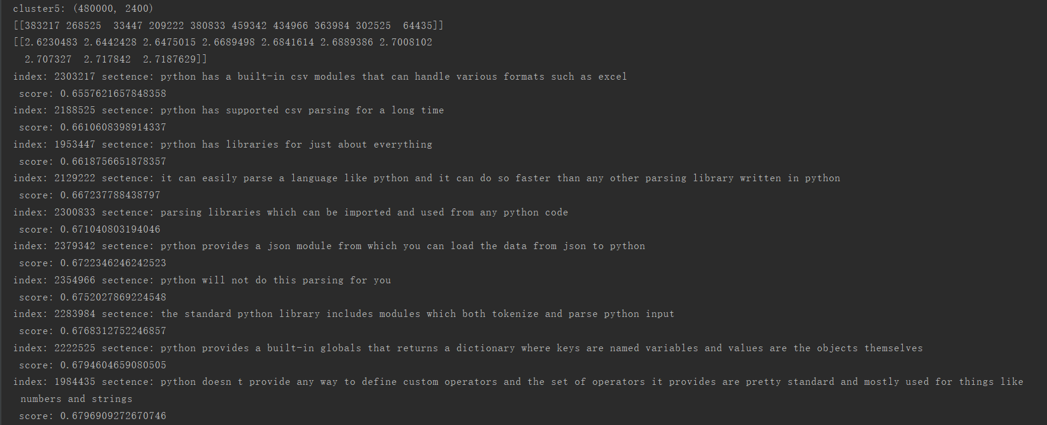
python provides both builtin methods and external libraries for creating modifying parsing and manipulating dates and times
Notes:
采用不同的特征表达形式可以构造出不同的滤波组

Slide 36
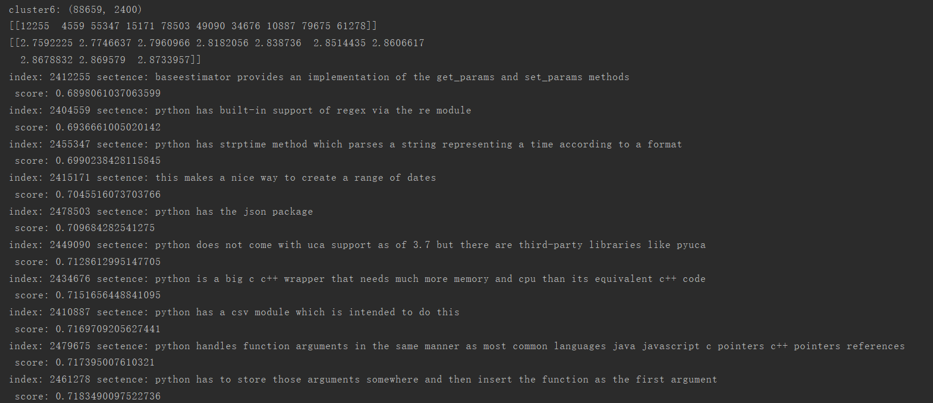
python provides both builtin methods and external libraries for creating modifying parsing and manipulating dates and times
Notes:
采用不同的特征表达形式可以构造出不同的滤波组

Slide 37
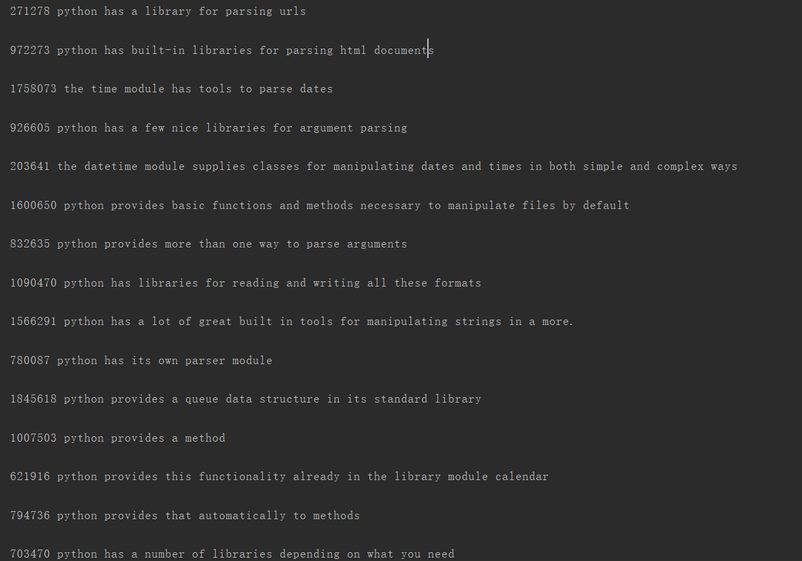
python provides both builtin methods and external libraries for creating modifying parsing and manipulating dates and times
Notes:
采用不同的特征表达形式可以构造出不同的滤波组

Slide 38
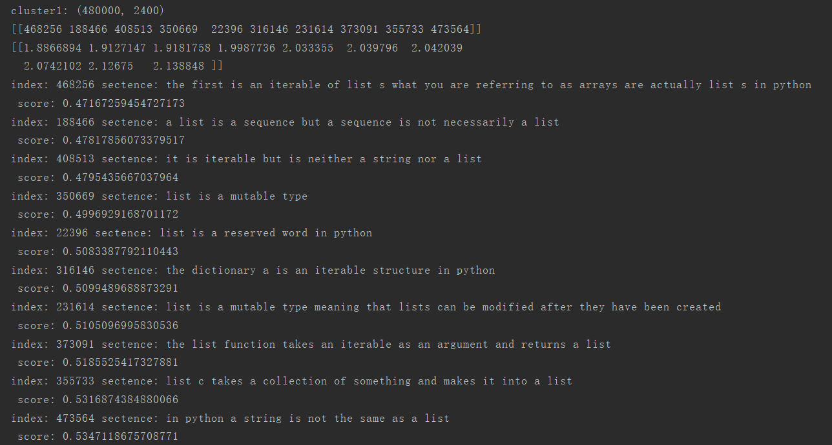
list is a particular type of iterable but it is not the only one that exists in python
Notes:
采用不同的特征表达形式可以构造出不同的滤波组

Slide 39
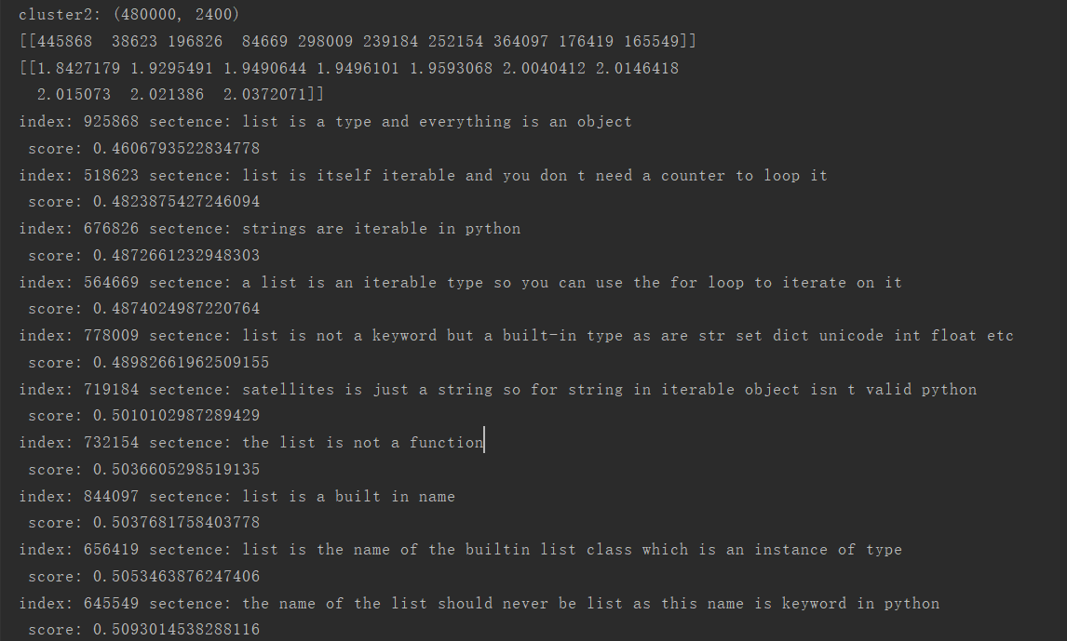
list is a particular type of iterable but it is not the only one that exists in python
Notes:
采用不同的特征表达形式可以构造出不同的滤波组

Slide 40
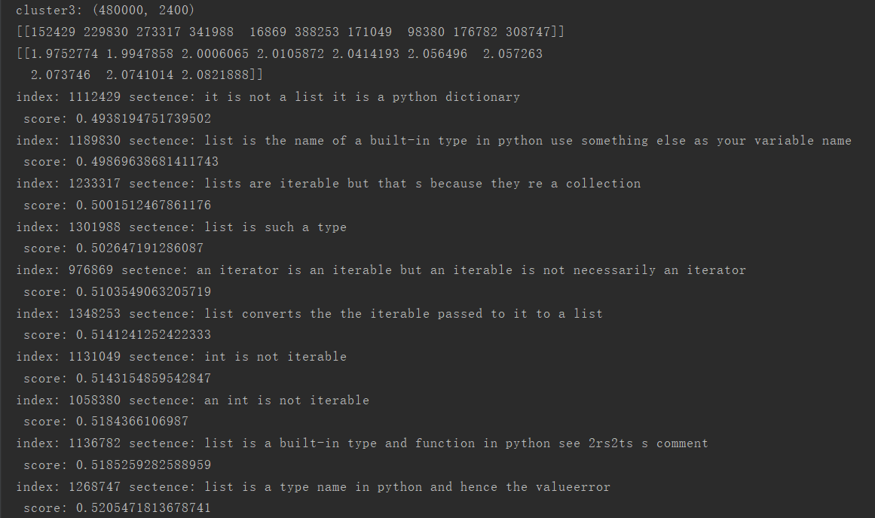
list is a particular type of iterable but it is not the only one that exists in python
Notes:
采用不同的特征表达形式可以构造出不同的滤波组

Slide 41
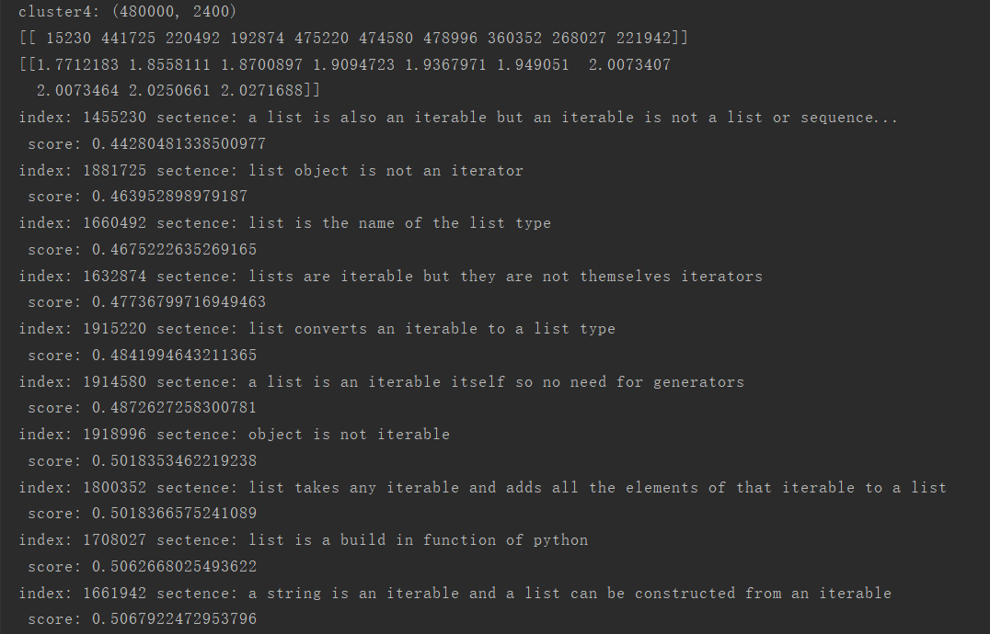
list is a particular type of iterable but it is not the only one that exists in python
Notes:
采用不同的特征表达形式可以构造出不同的滤波组

Slide 42
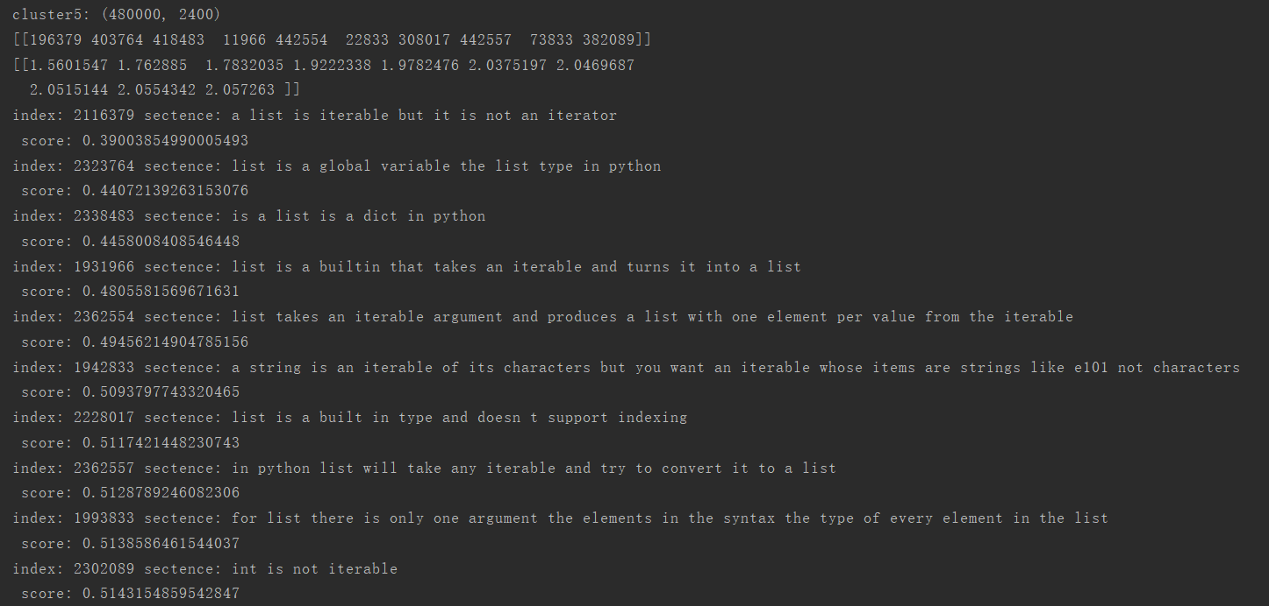
list is a particular type of iterable but it is not the only one that exists in python
Notes:
采用不同的特征表达形式可以构造出不同的滤波组

Slide 43
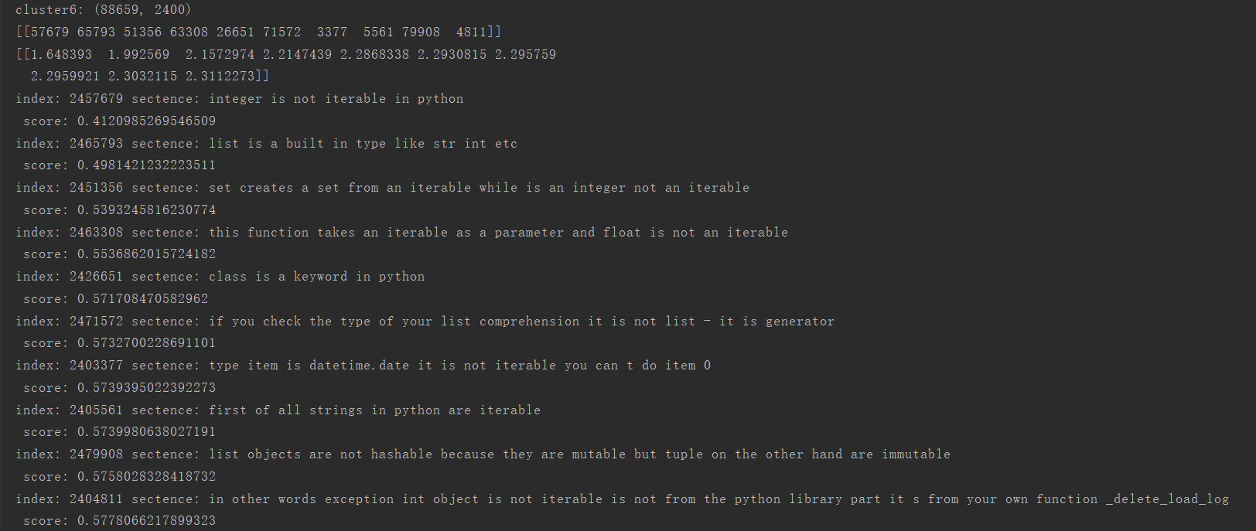
list is a particular type of iterable but it is not the only one that exists in python
Notes:
采用不同的特征表达形式可以构造出不同的滤波组

Slide 44
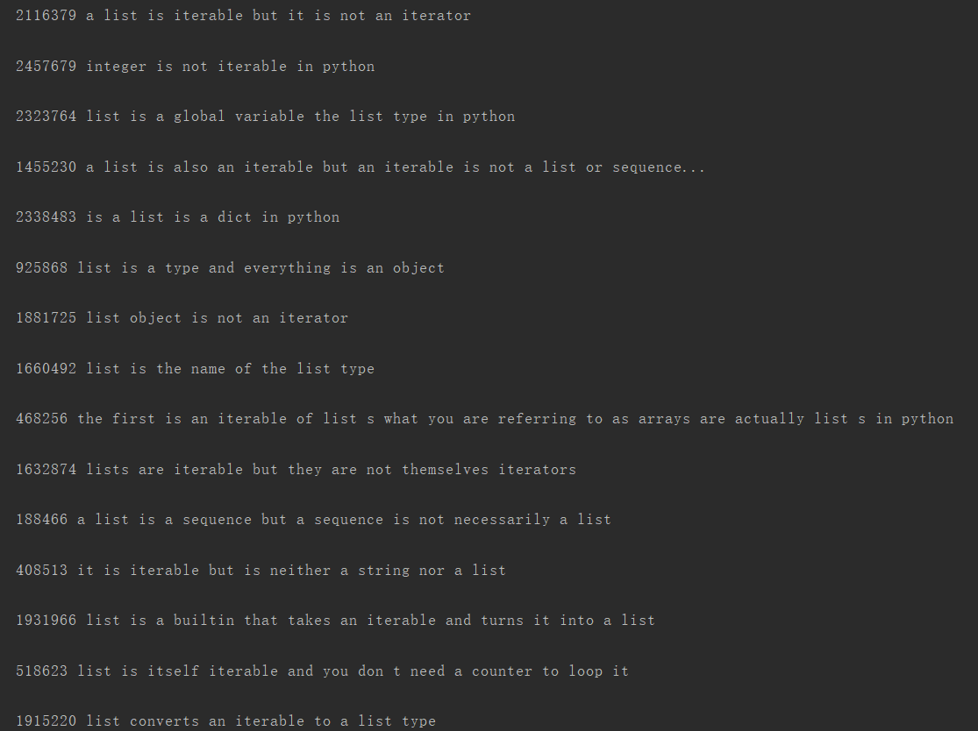
list is a particular type of iterable but it is not the only one that exists in python
Notes:
采用不同的特征表达形式可以构造出不同的滤波组

Slide 45
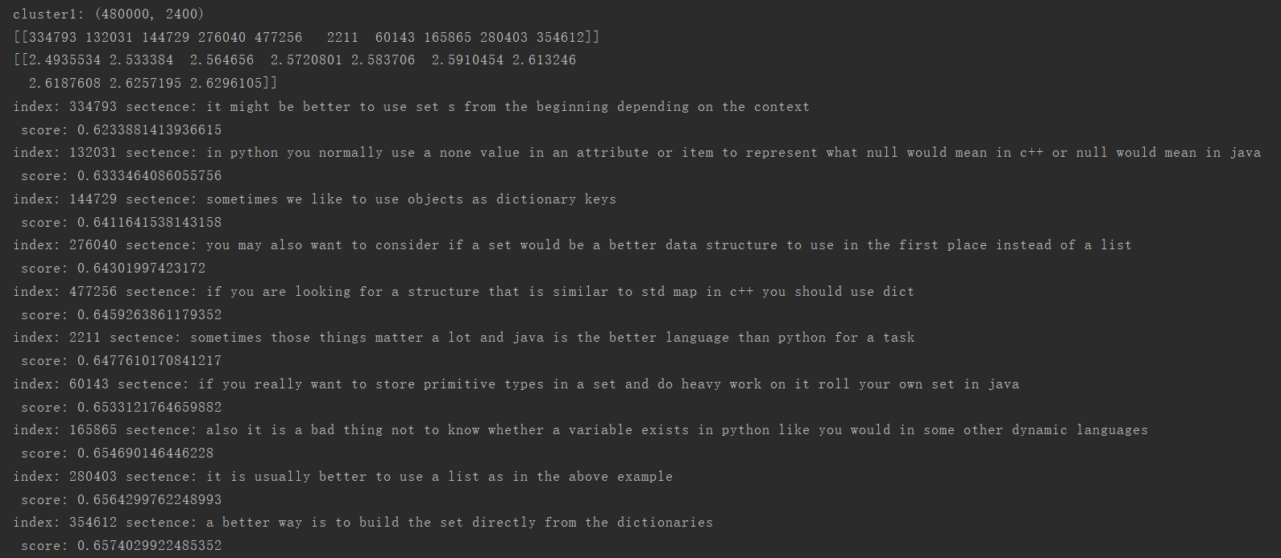
sometimes it will be better to use set tuple or dictionary list is the name given in python to dynamic arrays similar to from c++ or java
Notes:
采用不同的特征表达形式可以构造出不同的滤波组

Slide 46
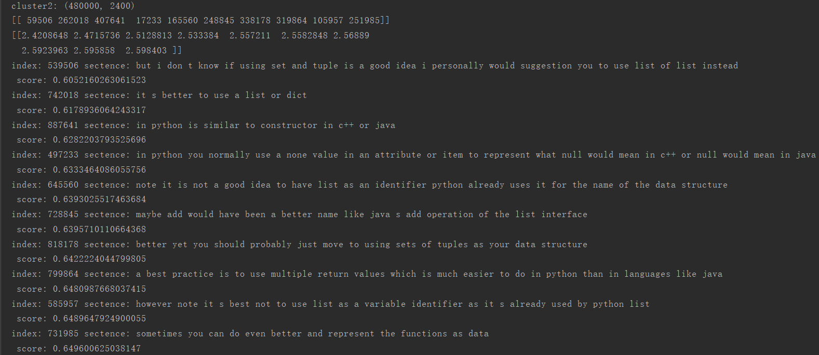
sometimes it will be better to use set tuple or dictionary list is the name given in python to dynamic arrays similar to from c++ or java
Notes:
采用不同的特征表达形式可以构造出不同的滤波组

Slide 47
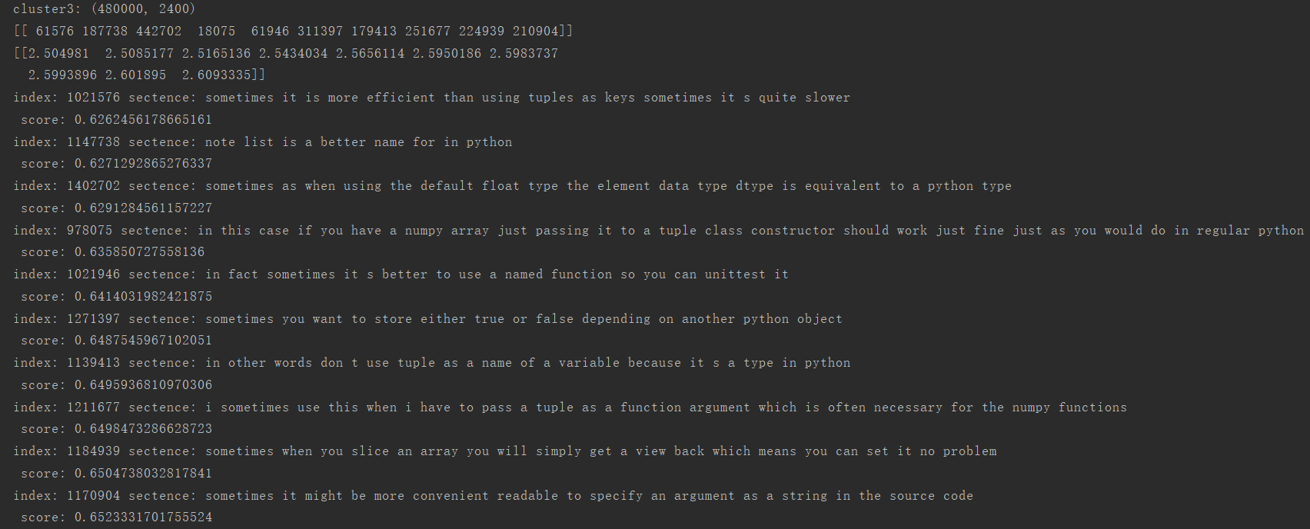
sometimes it will be better to use set tuple or dictionary list is the name given in python to dynamic arrays similar to from c++ or java
Notes:
采用不同的特征表达形式可以构造出不同的滤波组

Slide 48
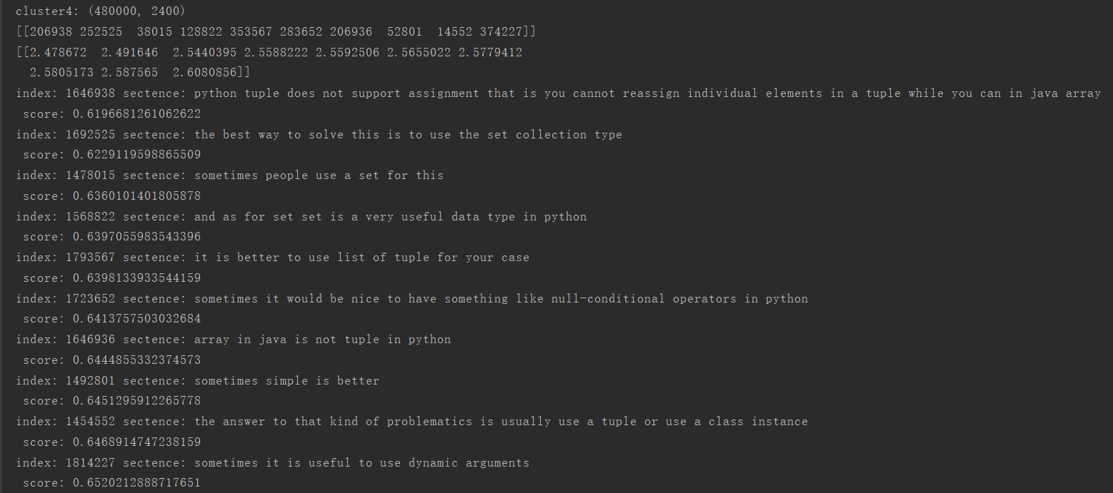
sometimes it will be better to use set tuple or dictionary list is the name given in python to dynamic arrays similar to from c++ or java
Notes:
采用不同的特征表达形式可以构造出不同的滤波组

Slide 49
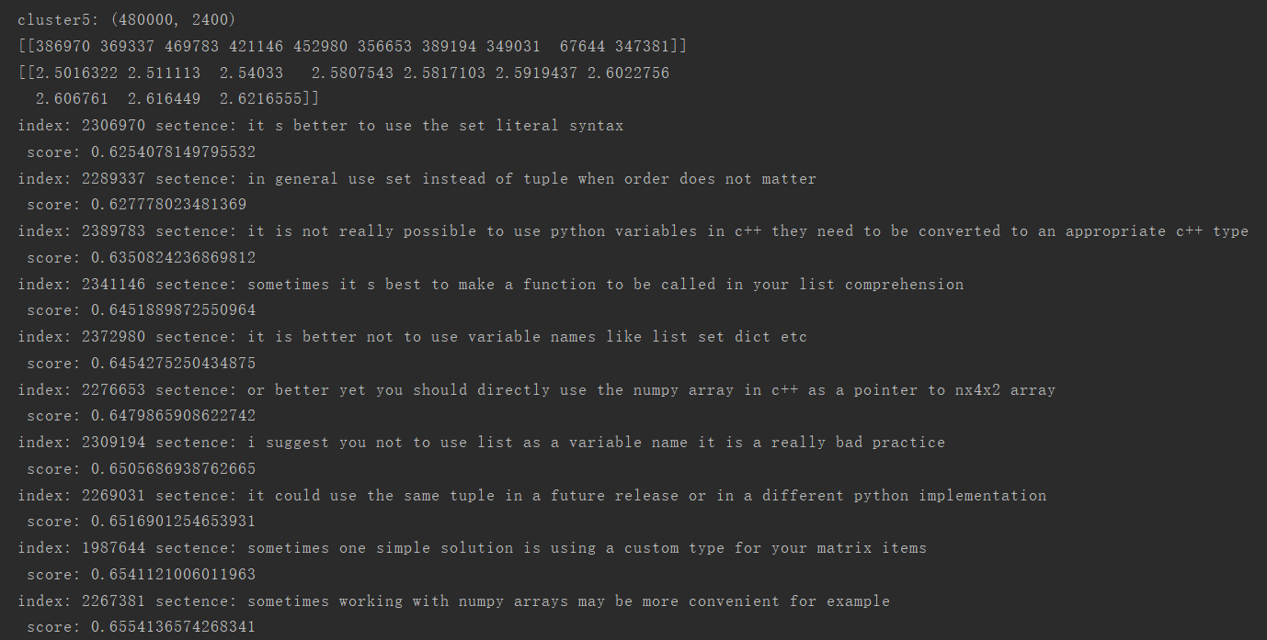
sometimes it will be better to use set tuple or dictionary list is the name given in python to dynamic arrays similar to from c++ or java
Notes:
采用不同的特征表达形式可以构造出不同的滤波组

Slide 50
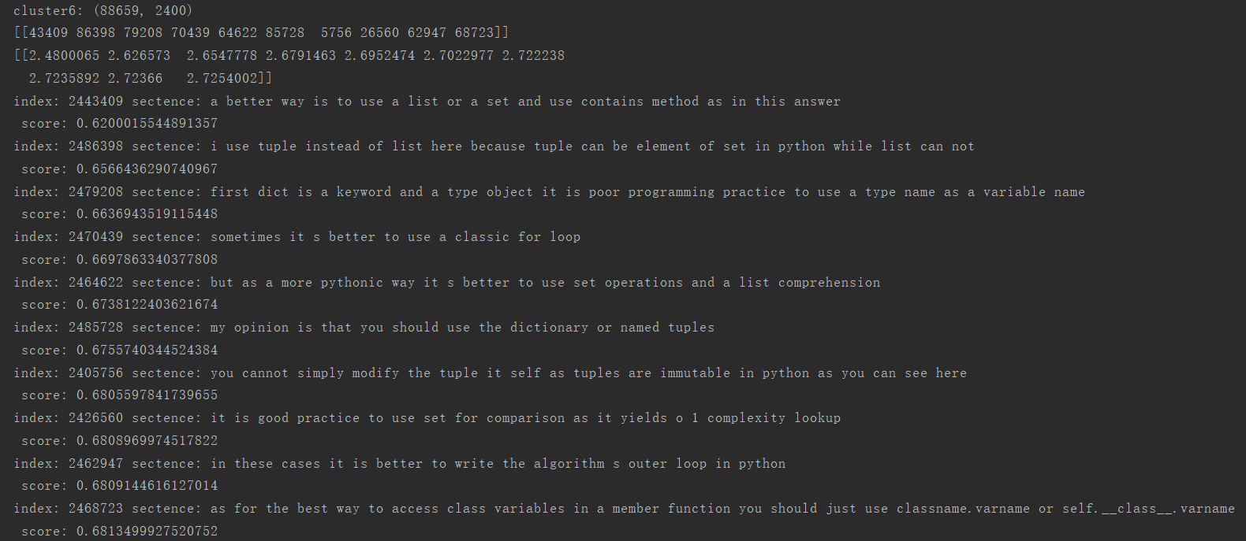
sometimes it will be better to use set tuple or dictionary list is the name given in python to dynamic arrays similar to from c++ or java
Notes:
采用不同的特征表达形式可以构造出不同的滤波组

Slide 51
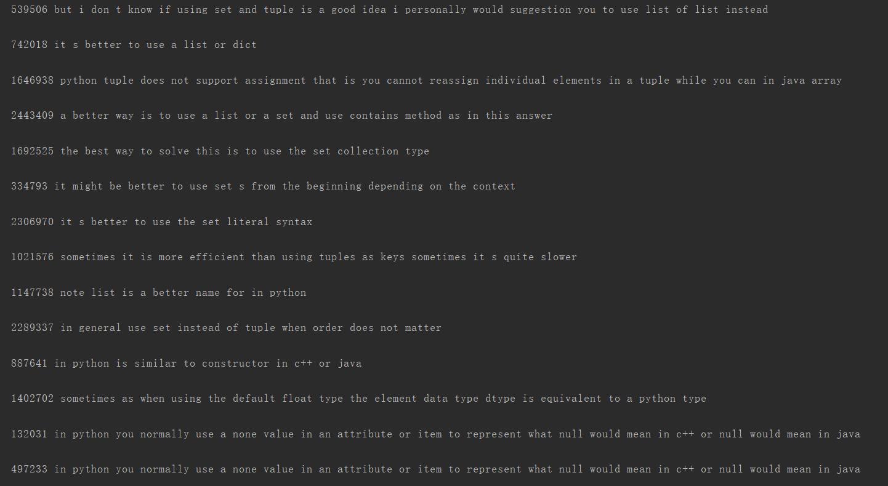
sometimes it will be better to use set tuple or dictionary list is the name given in python to dynamic arrays similar to from c++ or java
Notes:
采用不同的特征表达形式可以构造出不同的滤波组

Slide 52

python 3 receives new development and new features
Notes:
采用不同的特征表达形式可以构造出不同的滤波组

Slide 53

python 3 receives new development and new features
Notes:
采用不同的特征表达形式可以构造出不同的滤波组

Slide 54

python 3 receives new development and new features
Notes:
采用不同的特征表达形式可以构造出不同的滤波组

Slide 55

python 3 receives new development and new features
Notes:
采用不同的特征表达形式可以构造出不同的滤波组

Slide 56

python 3 receives new development and new features
Notes:
采用不同的特征表达形式可以构造出不同的滤波组

Slide 57

python 3 receives new development and new features
Notes:
采用不同的特征表达形式可以构造出不同的滤波组

Slide 58

python 3 receives new development and new features
Notes:
采用不同的特征表达形式可以构造出不同的滤波组

Slide 59
python 3 receives new development and new features
Notes:
采用不同的特征表达形式可以构造出不同的滤波组

Slide 60
Q&A

